Slide 1
Project 8
ABC Call Volume Trend Analysis
From: Avinash Nayak
Hyperlink to the Excel Sheet:
https://docs.google.com/spreadsheets/d/1dXOySIm7Z73xGi562kWFqytLn96S0VAy/edit?usp=sharing&ouid=115294475465194571559&rtpof=true&sd=true
Hyperlink to the iPython Notebook:
https://drive.google.com/file/d/1LKK1T3dHTVs8g3J1N5E_w_P-Chf-RkZJ/view?usp=sharing

Slide 2

Project Description
This Project is about analyzing patterns in the Call data of Customers in order to improve services of Inbound Customer Support.
These insights will be helpful for Customer Experience team of the organization who will analyze the data and gain meaningful insights from it.
As a Data Analyst, we received dataset with details about the incoming calls and queries and we are required to analyze the data and provide insights to those queries.
To do this, we will use Python programming language for data pre-processing and Microsoft Excel for EDA to get the required insights.
Image Source: Google Images

Slide 3

Approach
We had received a dataset containing information about the Incoming Calls from Customers like call duration, phone number, call attended or not etc.
We first tried to understand the whole dataset.
Then we performed Data Pre-Processing where we checked and did necessary changes for missing data, error in data, outliers in data and duplicates in data.
Then we directly started performing EDA as per the queries we had. We also plotted some graphs for better understanding. Then we drew conclusions and insights based on the filtered data and the plots.
Now, since we got all the insights required, we will make a detailed report about it.
Image Source: Google Images

Slide 4



Tech-Stack Used
Python 3.10.9 – Programming language used for Data Pre-processing.
Jupyter Notebook 6.5.2 – Interactive platform to write and execute codes in various programming languages (in this case Python).
Microsoft Excel 2016 – A spreadsheet editor software used mainly by professionals to enter data in table format, perform computations, plot graphs etc.
Image Source: Google Images

Slide 5
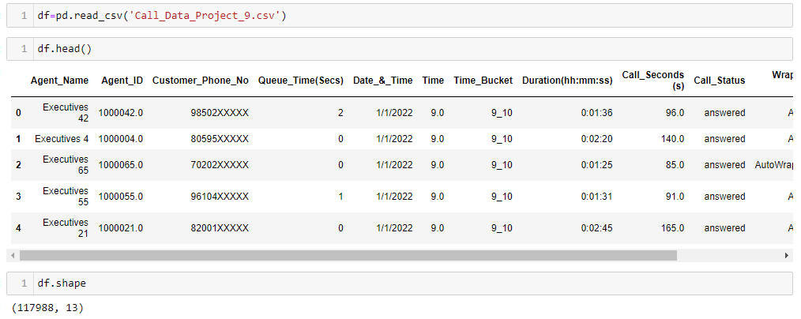
Dataset Information
The Dataset named Call_Data_Project_9.csv has 117988 rows (datapoints) and 13 columns (features).

Slide 6
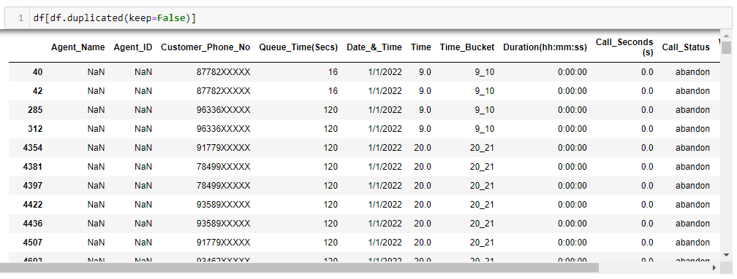

Data Pre-Processing
1. Checking for duplicates of entire row
Action:
Keeping one, dropped rest of the duplicates.

Slide 7
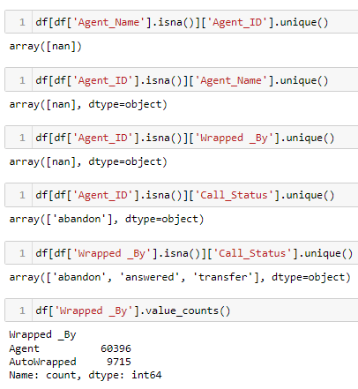
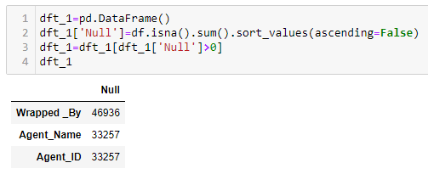
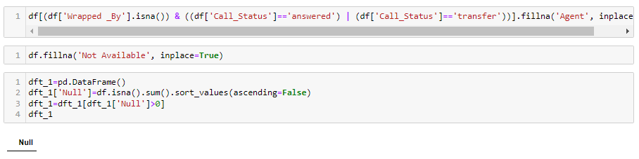
Data Pre-Processing
2. Checking for null values column wise
Action:
We found that all the rows where Agent_Name and Agent_ID was Null are rows denoting abandoned calls.
Some calls where Wrapped _By was Null were answered or transferred calls. So replaced them with value ‘Agent’.
Rest of the Null values were replaced by value ‘Not Available’

Slide 8
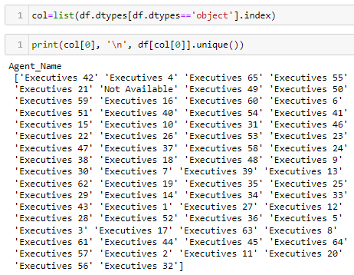

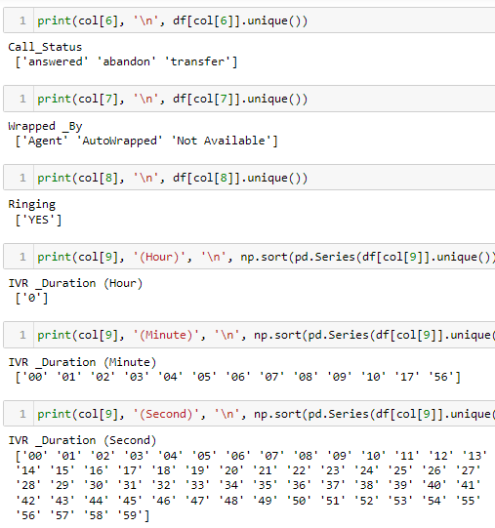
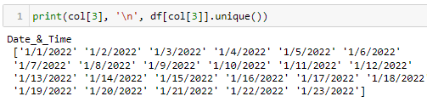
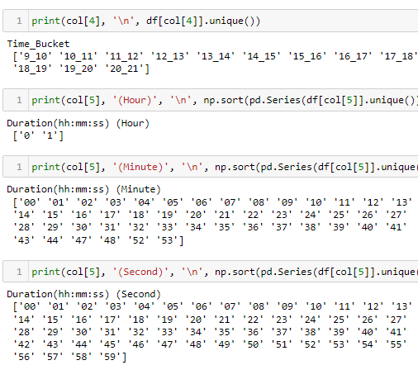
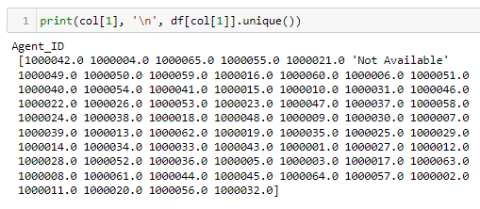
Data Pre-Processing
3. Checking of errors in Categorical columns.

Slide 9
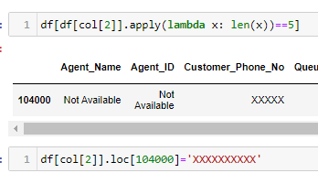
Data Pre-Processing
4. Dealing with errors in Customer_Phone_No column.
Action:
As the above process showed that Customer_Phone_No column had row(s) with 5 digit number which is an error.
So we checked and found one such row and replaced the column value with ‘XXXXXXXXXX’

Slide 10


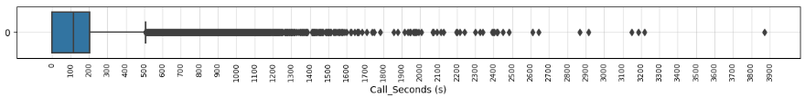
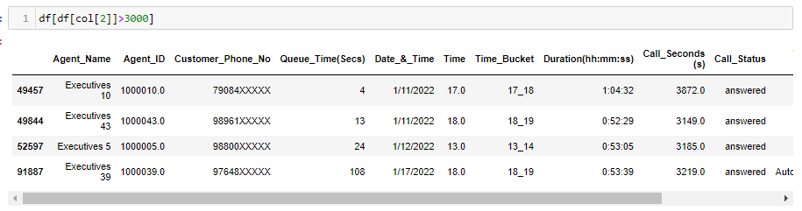
Data Pre-Processing
5. Dealing with Outliers in Queue_Time(Secs) Column.
Queue_Time(Secs) Duration seemed okay. No changes required.
6. Dealing with Outliers in Time Column.
All the column values seemed okay. No changes required.
7. Dealing with Outliers in Call_Seconds (s) Column.
Considered 3000 as the threshold value for being an Outlier. Found 4 rows with Call_Seconds (s) column value greater than 3000. On further investigation, didn’t found anything unusual. So nothing was changed.

Slide 11
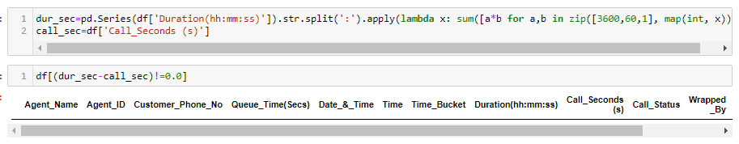
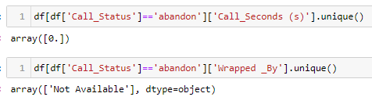
Data Pre-Processing
8. Dealing with inconsistencies in Duration(hh:mm:ss) and Call_Seconds (s) column values.
There is no inconsistency between the two column values.
9. Dealing with inconsistencies in Call_Status and Call_Seconds (s) column values and between Call_Status and Wrapped _By column values
There is no inconsistency between both the cases of the two column values.

Slide 12
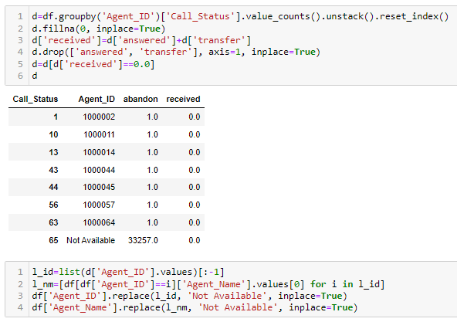
Data Pre-Processing
10. Dealing with inconsistencies in Agent_ID column values.
There were some rows where Agent_ID had a proper value but the agent didn’t receive any calls.
So changed these Agent_ID values and Agent_Name values to ‘Not Available’.

Slide 13
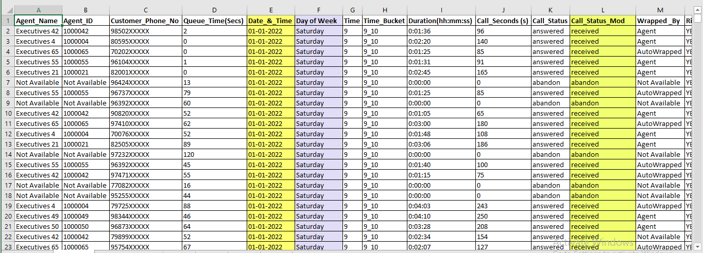
Data Pre-Processing
11. Changes in th Excel sheet format for better analysis.
Changed format of the dates in Date_&_Time column.
Feature Engineering: Created two new columns, Day of Week from Date_&_Time column and Call_Status_Mod where column values of answered and transfer in Call_Status column are clubbed together as received and abandon is kept as it is.

Slide 14
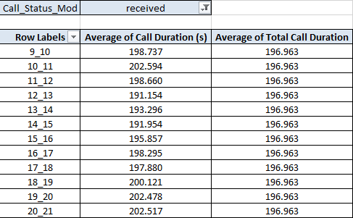
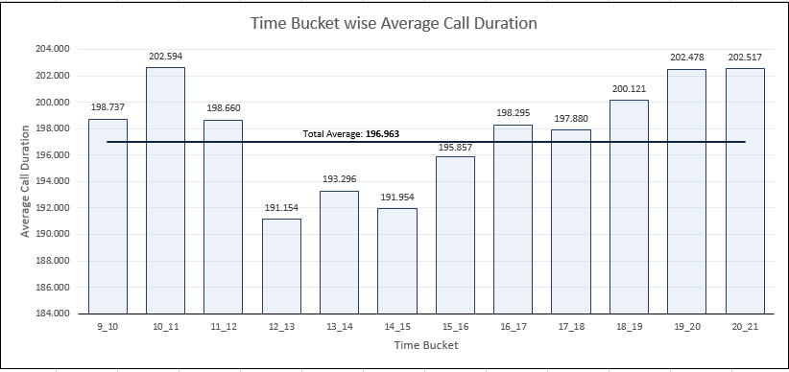
Analysis
Task 1: Average Call Duration: Determine the average duration of all incoming calls received by agents. This should be calculated for each time bucket.
Your Task: What is the average duration of calls for each time bucket?
The overall Average Call Duration is 196.963 seconds.
We can observe that the Average Call Duration first peaks in the morning hours before dropping to below average value during the lunch hours and then again increasing to above average value.

Slide 15
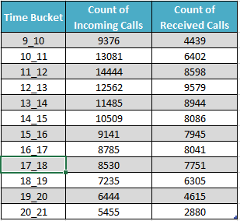
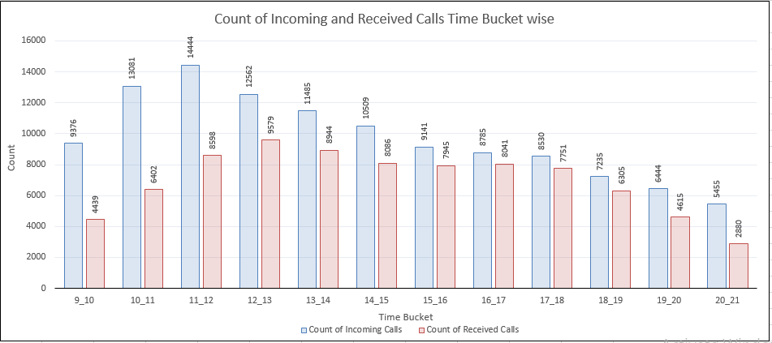
Analysis
Task 2: Call Volume Analysis: Visualize the total number of calls received. This should be represented as a graph or chart showing the number of calls against time. Time should be represented in buckets (e.g., 1-2, 2-3, etc.).
Your Task: Can you create a chart or graph that shows the number of calls received in each time bucket?
We can observe that the number of received calls received first increases with time before dropping down.
We can also observe that the number of abandoned calls are very high in the morning hours and as the day progresses, the number of abandoned calls reduces.

Slide 16
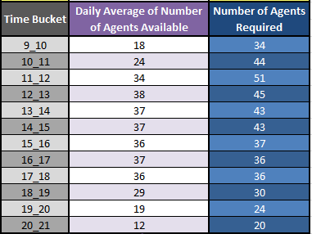
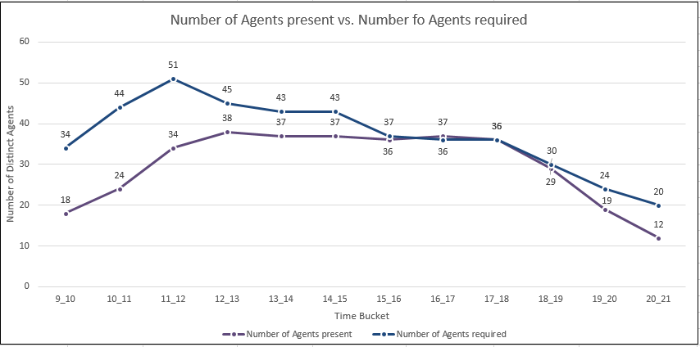
Analysis
Task 3: Manpower Planning: The current rate of abandoned calls is approximately 30%. Propose a plan for manpower allocation during each time bucket (from 9 am to 9 pm) to reduce the abandon rate to 10%. In other words, you need to calculate the minimum number of agents required in each time bucket to ensure that at least 90 out of 100 calls are answered.
Your Task: What is the minimum number of agents required in each time bucket to reduce the abandon rate to 10%.
We can observe that to maintain a maximum of 10% abandon rate, we need to increase the availability of agents in the morning hours by a large margin as in these hours, the number of incoming calls are quite high and the number of agents available currently are quite low.
During afternoon hours and during late evening hours, we need to increase the availability of agents by a slight margin to maintain a maximum of 10% abandon rate.

Slide 17
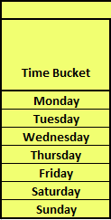
Analysis
Task 4: Night Shift Manpower Planning: Customers also call ABC Insurance Company at night but don't get an answer because there are no agents available. This creates a poor customer experience. Assume that for every 100 calls that customers make between 9 am and 9 pm, they also make 30 calls at night between 9 pm and 9 am. The distribution of these 30 calls is as follows:
Your Task: Propose a manpower plan for each time bucket throughout the day, keeping the maximum abandon rate at 10%.
From the above heatmap, we can observe that for day of the week, Monday requires the most number of agents in individual time buckets as well as for the overall day as it is starting of the week.
For rest of the days, agent requirement remains more or less the same with Saturday’s and Sunday‘s requirement on the lower side as they are weekends.
For individual time buckets, the most number of agents required is in the morning hours from 9 A.M to 1 P.M and the least number of agents required is at night hours from 12 A.M to 5 P.M.

Slide 18

Result
Through this project, I was able to understand the importance of Data Analytics in Customer Experience Analysis as it provides valuable insights which helps in making Data-Driven Decisions.
In this project I was able to get insights like call abandon rates, distribution of call duration, number of calls, agents, how to create a manpower plan so as to decrease abandon calls etc. I also got experience in Data Preprocessing like Data Cleaning, handling Outliers, Feature Engineering etc. in this project. I can communicate the insights to relevant stakeholders as per the requirements using which they can make proper data-driven decisions.
This Project has also helped me in understanding the various functions of Python and Excel and its working.
Image Source: Google Images

Slide 19
Thank You
Contact: avi22nayak@gmail.com

